Slide 1
EEGLAB Tutorial
- 22 channels
(20−10 electrode placement system)
Jiazhen Hong
May 2021

Slide 2
BCI Competition IV - IIa
Jiazhen Hong
Data Type: GDF
Analysis tool: EEGLAB
Package: Biosig

Slide 3
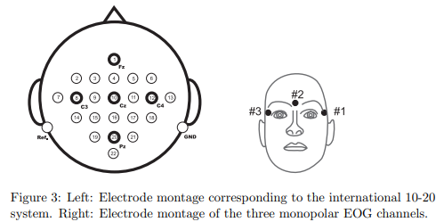
22 channel EEG
EOG

Slide 4
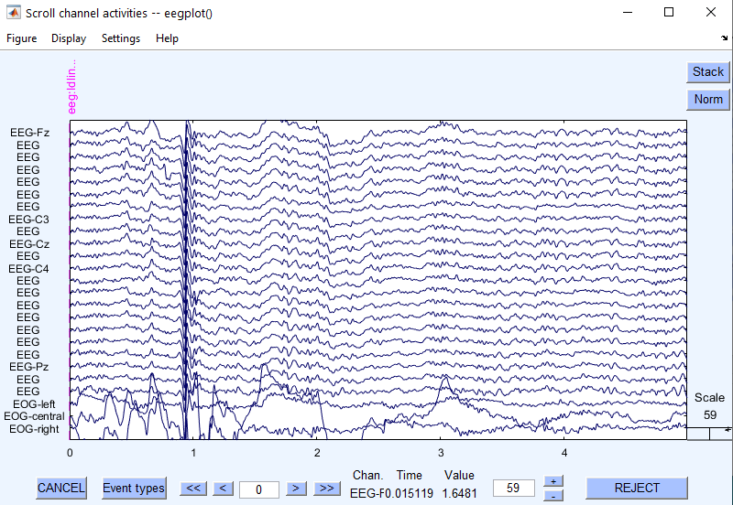

Slide 5
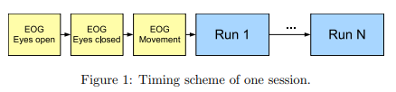
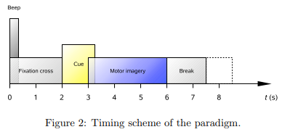
2min
1min
1min
4s
1.25s

Slide 6
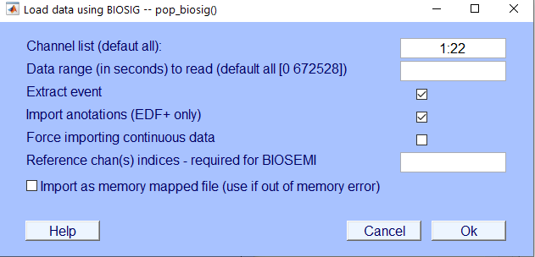
Channel select

Slide 7
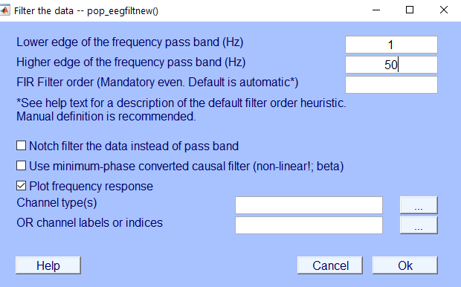
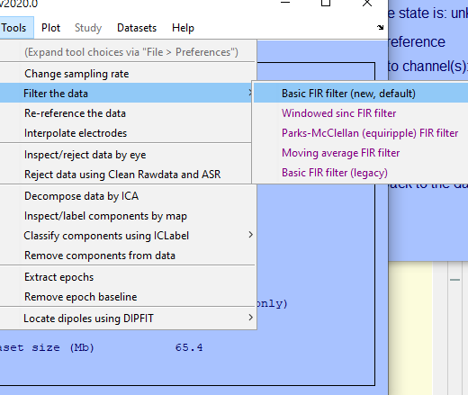
1 - Filter [1 50] hz

Slide 8
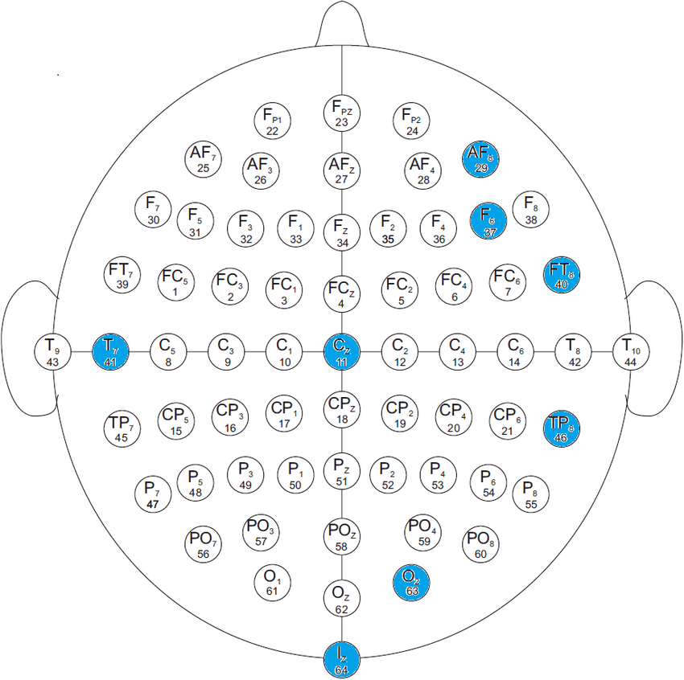
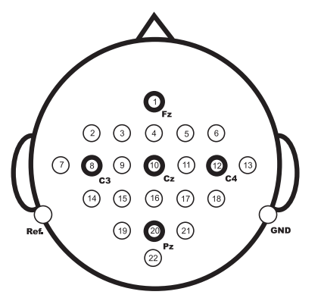
2-location
FC3
FC1
FCz
FC2
FC4
c5
c1
c2
c6
CP3
CP1
CPz
CP2
CP4
P1
P2
POz

Slide 9
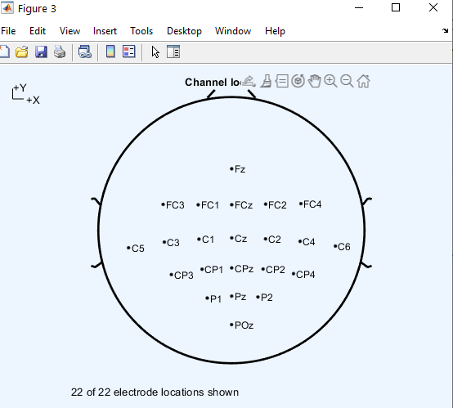

Slide 10
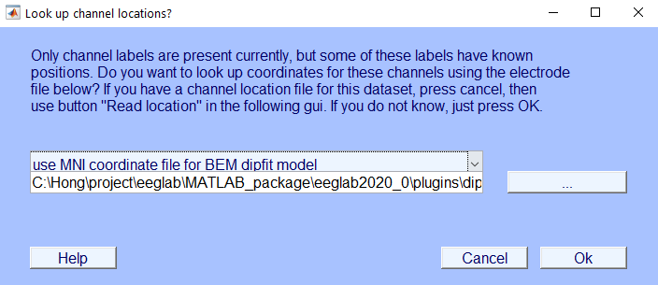
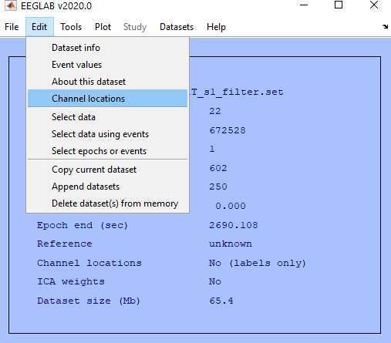
2 - location

Slide 11
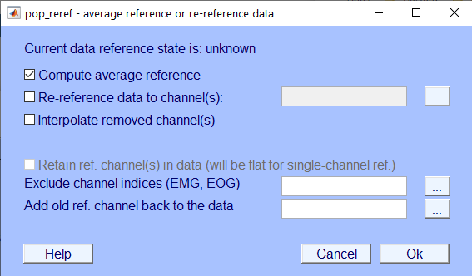
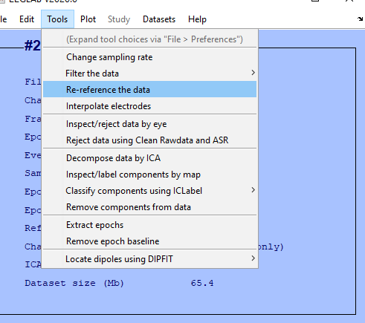
3 - ref: average

Slide 12
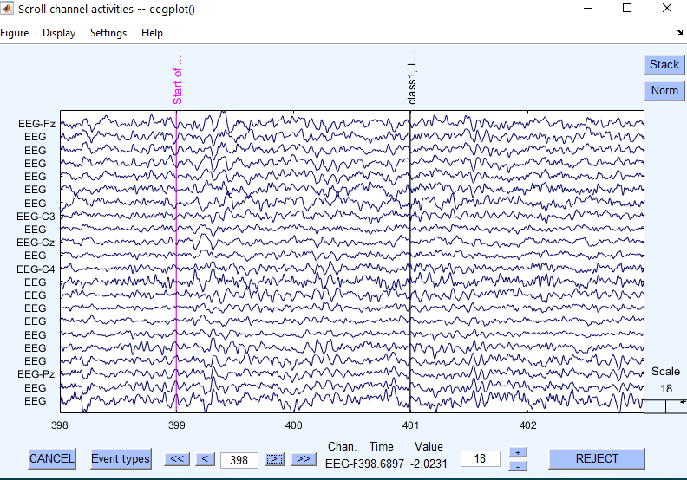
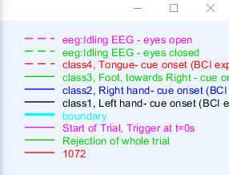
4 - flag event select (1)

Slide 13
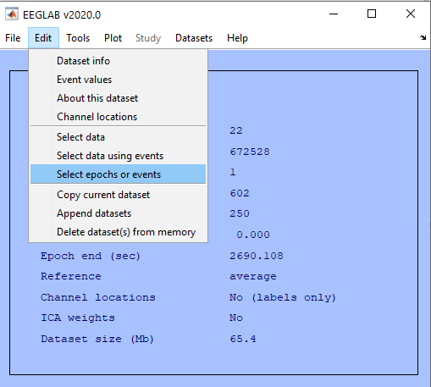
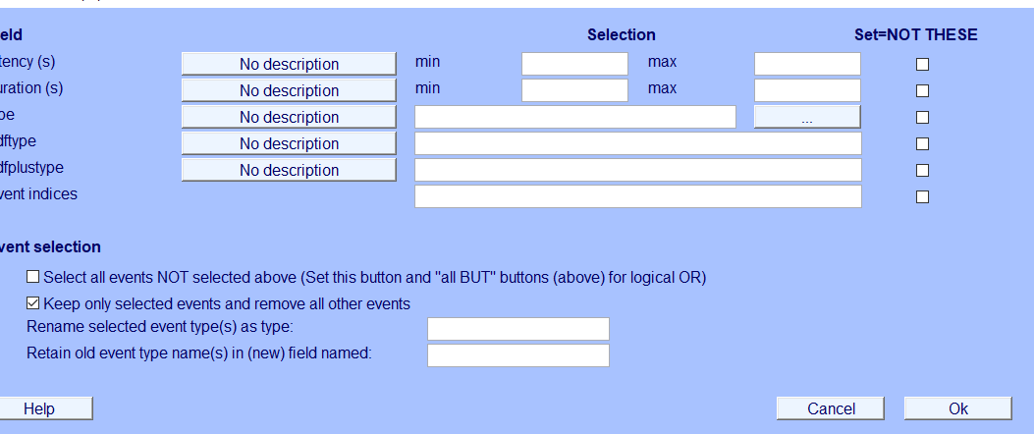
4 - flag event select (2)

Slide 14
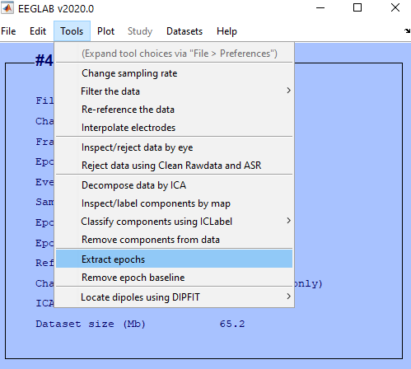
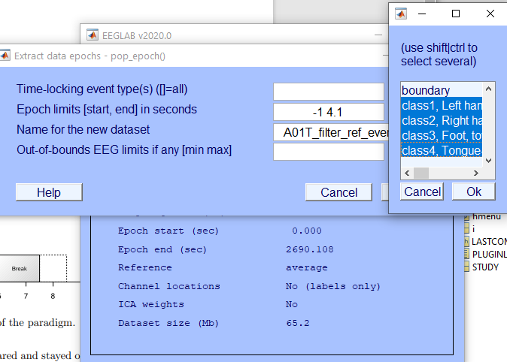
5 - extract epochs [-1 4.1] (cue: 0-1.25s, mi: 1-4s)

Slide 15
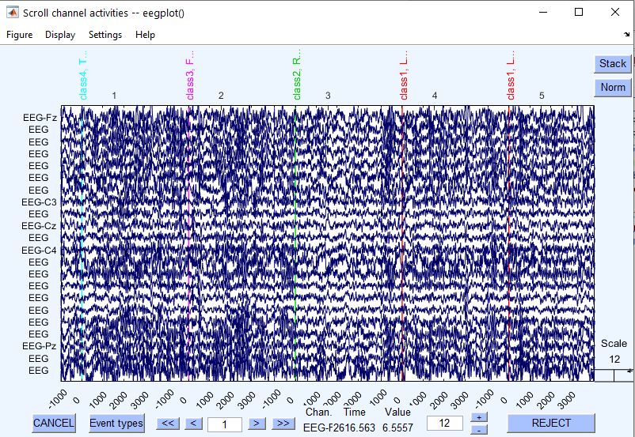
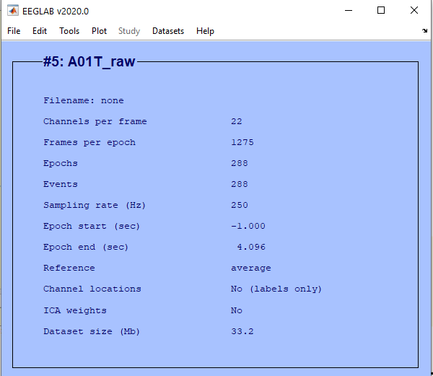
Demo after step5. And we name is **raw
4*72 = 288

Slide 16
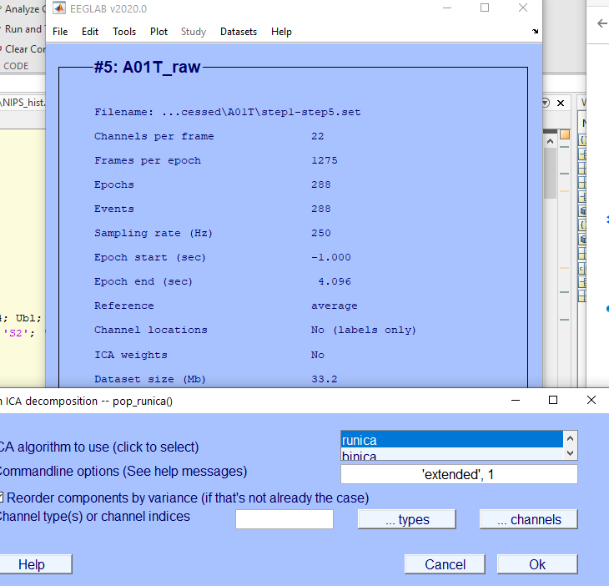
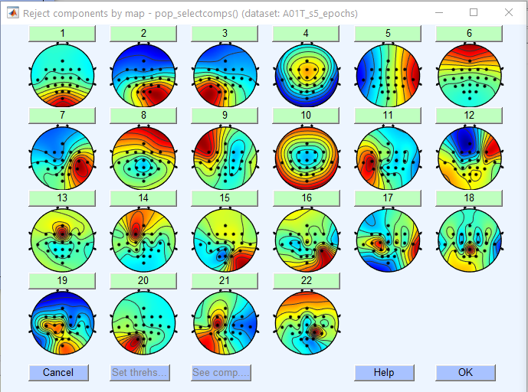
6 - ICA
Observation by hand

Slide 17
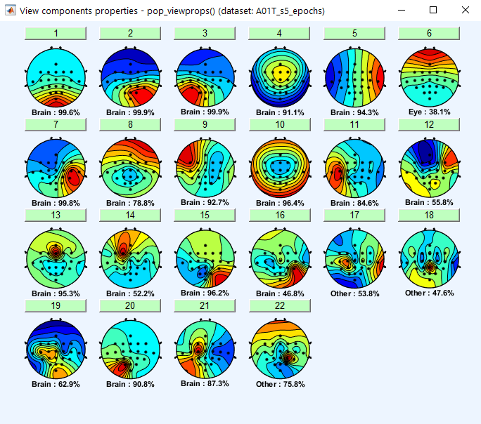
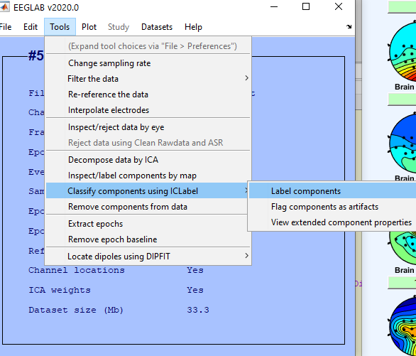
Mark 6 17 18 22
Observation auto

Slide 18
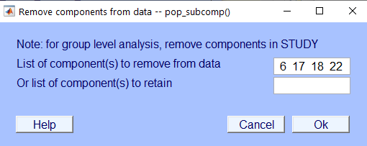
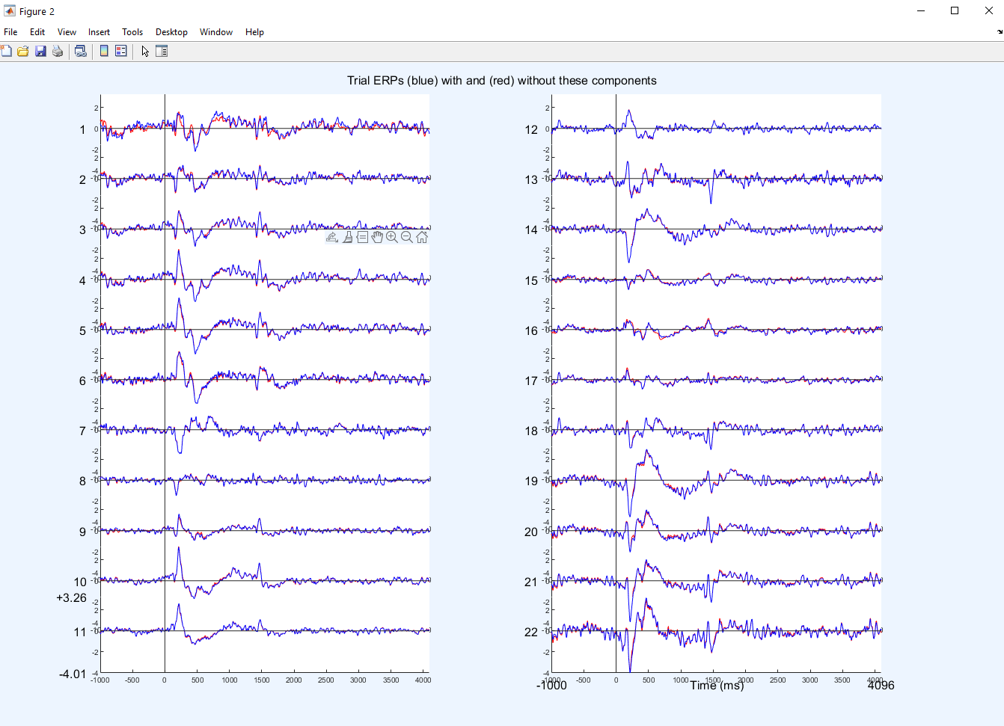
7 - Remove components

Slide 19
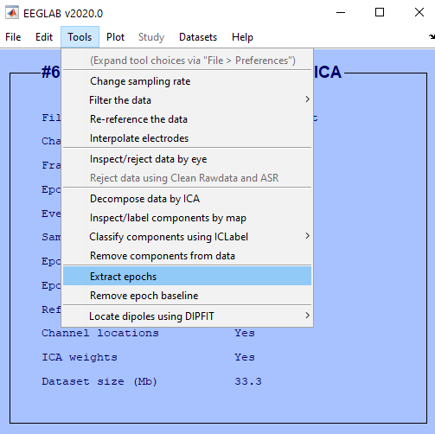
8 - divided data

Slide 20
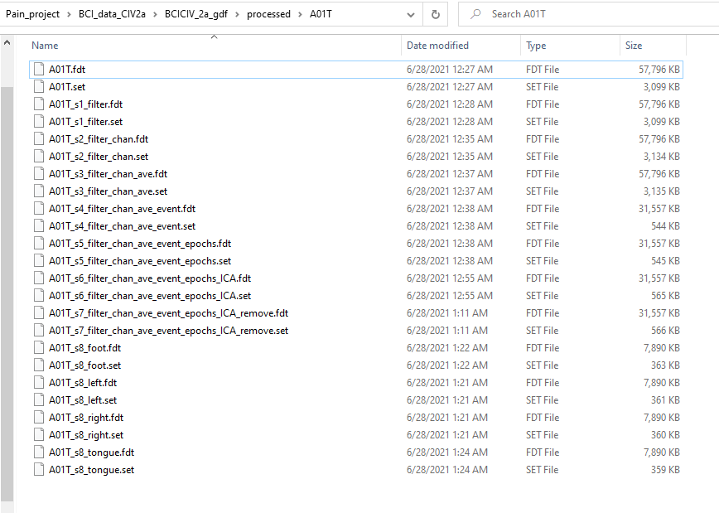
Overview

Slide 21
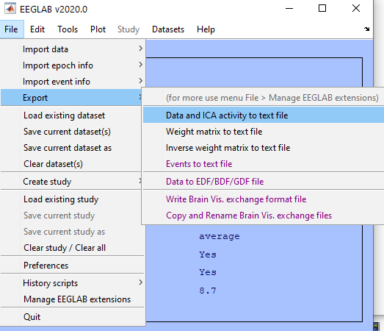
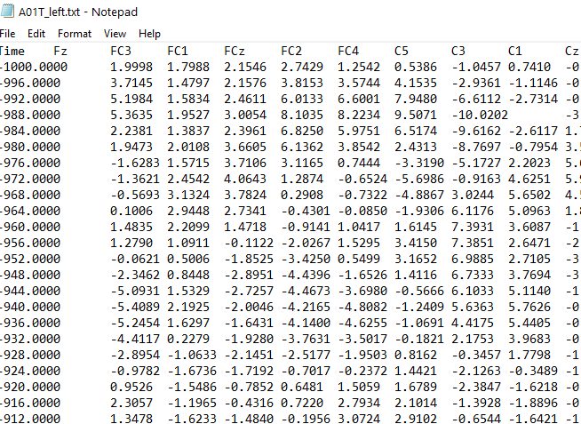
Export data

Slide 22
Appendix

Slide 23
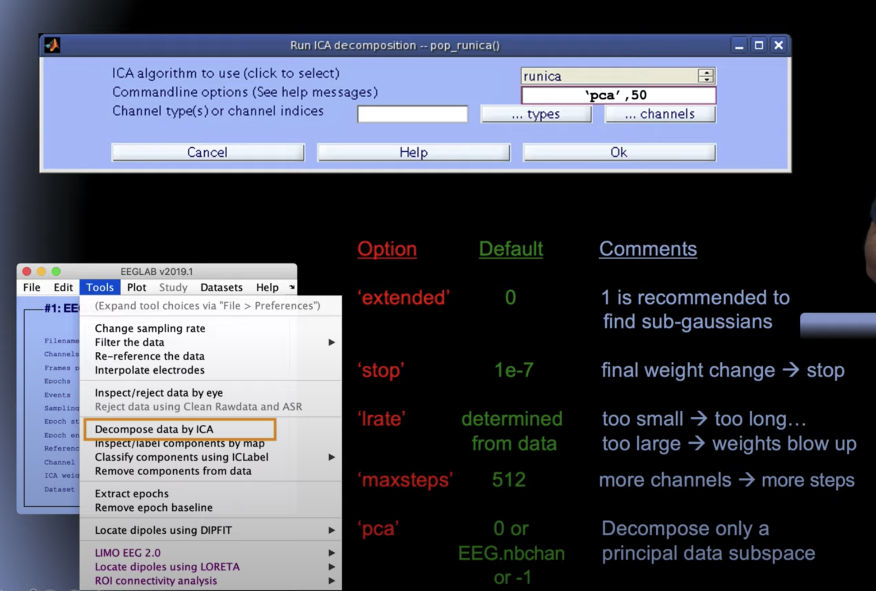
ICA method

Slide 24
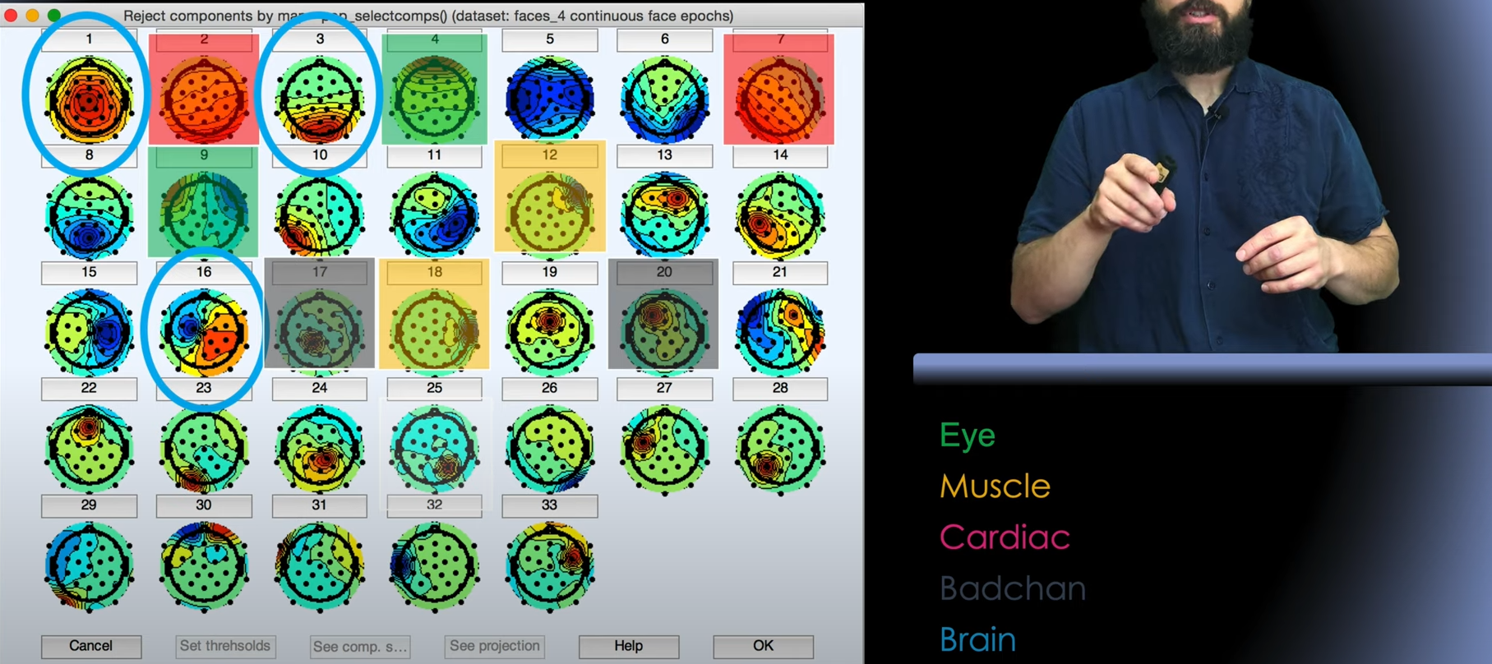
Component remove

Slide 25
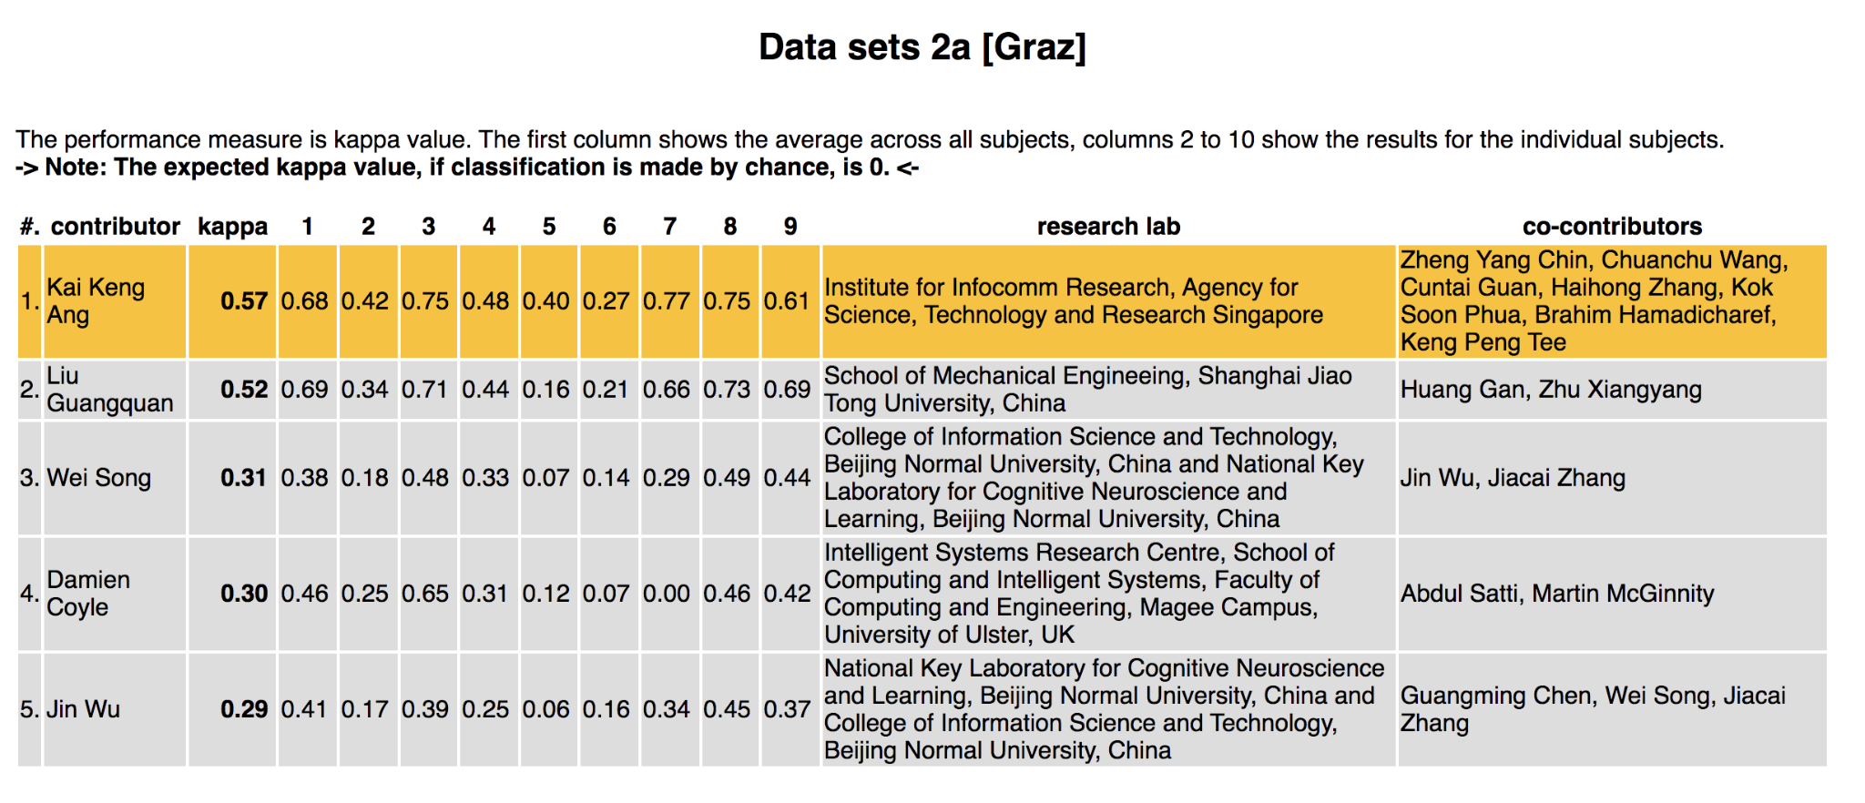
Result 2a Kappa value is required

